Slide 1
LOCATION SELECTION FOR DENTAL CLINIC
In Kuala Lumpur, Malaysia
SL Tan, 2021

Slide 2
TABLE OF CONTENTS
01
04
02
05
03
INTRODUCTION
ANALYSIS
Background
Data analysis & selection criteria
BUSINESS PROBLEM
RESULT & CONCLUSION
Problem Statement
Result and recommendations
DATA
Data Sources and its preparation

Slide 3
INTRODUCTION
Malaysia is a country located in South East Asia, with over 32 million of population ^{[1]}.
According to the Health Minister Datuk Seri Dr Adham Baba, Malaysia has a total 11,059 dentists as of June 2020, with the dentist-population ratio at 1:2,963 ^{[2]}. There isn't an ideal population-to-dentist ratio recommended by WHO, however, if we compare to the U.S which has ratio of 1:1,638 ^{[3]}, this suggests that there are plenty of opportunities in providing dentistry service in Malaysia.

Slide 4
BUSINESS PROBLEM
To select an optimal location to open a dental clinic in
Kuala Lumpur (capital of Malaysia).
Surrounded by medical centers that offers non-dental services
No dental clinic within the vicinity
Near to Kuala Lumpur city center

Slide 5
DATA SOURCE & PREPARATION
4. Use Foursquare to populate more locations to use as center points.
2. Use geo-location determine the location of Kuala Lumpur city center.
6. Use Foursquare again to look for the medical centers nearby with clear marking on dental clinics for each of 678 center points.
1. Gather the postcode of Kuala Lumpur and its surrounding areas. ^{[3][4]}
3. 297 postcode are located within 10km of city center. To ensure that the full area can be covered by 500m radius of the center points, more center points are required.
5. 678 center points generated.

Slide 6
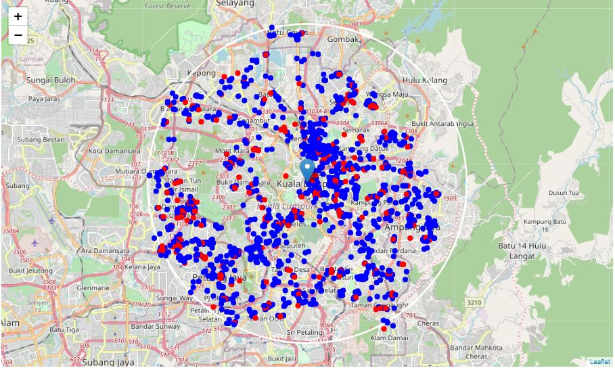
DATA
2,636 MEDICAL CENTER
329 DENTAL CLINIC
10km radius from Kuala Lumpur city center
Location of all Medical Centers wihin 10km radius from city center
Location of all Dental Clinics within 10km radius from city center
Result of the nearby search from the 678 center points using Foursquare

Slide 7
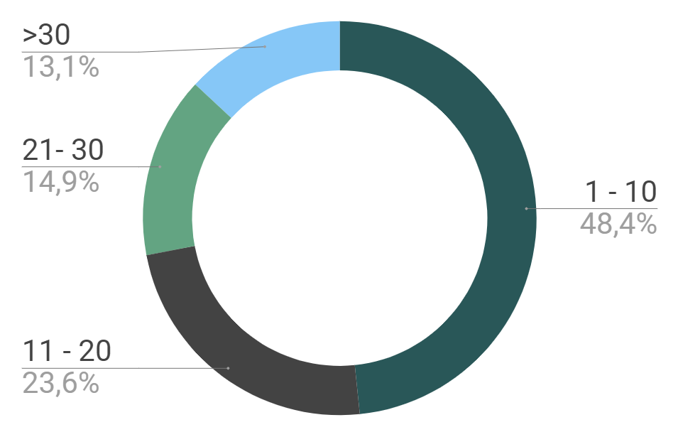
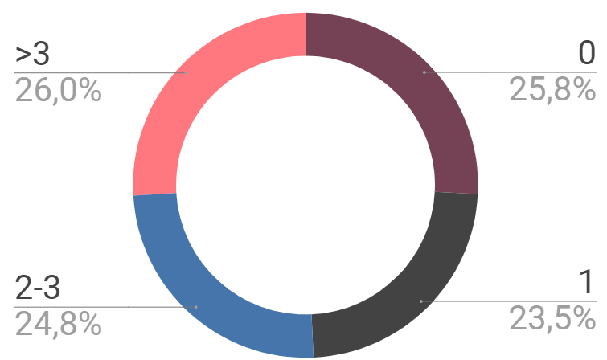
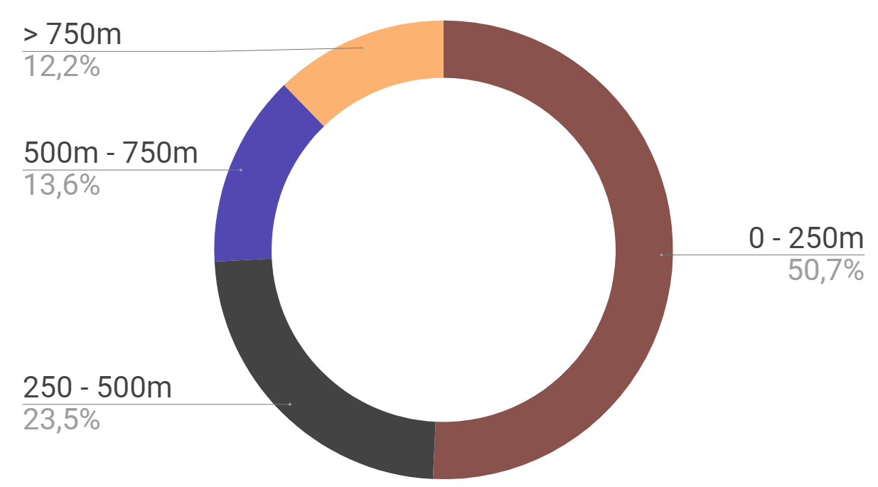
ANALYSIS
# of Medical Center nearby
Distance to nearest dental
# of Dental Clinic nearby
Average of 17.87 medical centers within the vicinity (500m) of the 678 center points
>25.8% of the 678 center points do not have any dental clinic within the vicinity (500m)
Averge distance of the 678 center points to the nearest dental clinic is ~340m

Slide 8
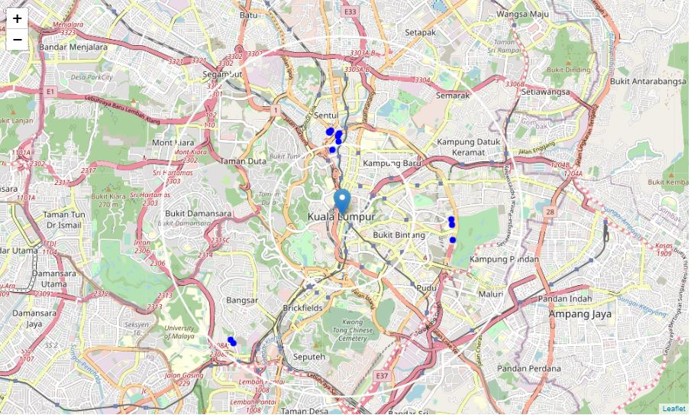
SELECTION CRITERIA
No dental clinic within the vicinity (500m)
5km radius
More than or equal to 18 medical centers within the vicinity
2km radius
5km from Kuala Lumpur city center
Locations fulfilled all 3 selection criteria

Slide 9
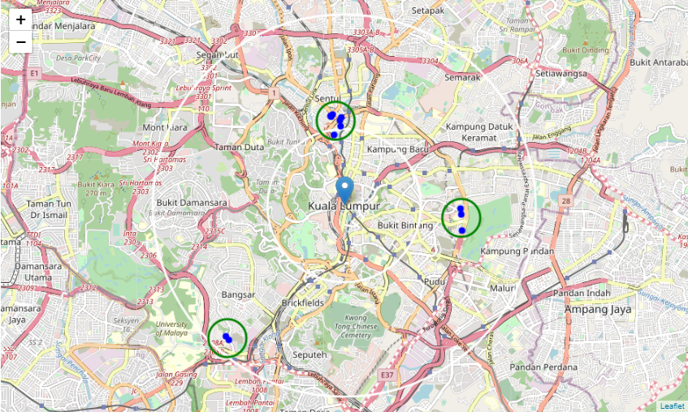
RESULTS
Jalan Tun Ismail
Neighborhood nearby local residential area
5km radius
Bukit Bintang
Located within the golden triangle and a tourist spot.
2km radius
Bangsar
Popular among the expatriates
Shortlisted locations form into 3 clusters.

Slide 10
CONCLUSION
“We have explored the locaton of medical centers and dental clinics that are within the 10km of Kuala Lumpur city center. We noticed the distribution of dental clinics is not evenly spread out, where there are number of pockets that do not have dental clinics”
“We have then select the locations that have high medical center density with no existing dental clinics. As there are many choices available, we have then narrow down our selection to look into locations that are within 5km of city center (compared to initial 10km)”
“This has then arrived our final recommendations of 3 areas – Jalan Tun Ismail, Bangsar and Bukit Bintang. Each area has its own characteristics. To select the most optimal location, it is recommended to also consider the respective business strategy, target customers, social and economic factors during the decision making.
”

Slide 11
THANK YOU!

Slide 12
APPENDIXS
^{[1]} Current Population Estimates, Malaysia, 2021 https://www.dosm.gov.my/v1/index.php?r=column/cthemeByCat&cat=155&bul_id=ZjJOSnpJR21sQWVUcUp6ODRudm5JZz09&menu_id=L0pheU43NWJwRWVSZklWdzQ4TlhUUT09
^{[2]} 'Msia doctor-population ratio stands at 1: 454' by New Straits Times, 2020 https://www.nst.com.my/news/nation/2020/08/613844/msia-doctor-population-ratio-stands-1-454
^{[3]} Kuala Lumpur Postcode list http://malaysia.postcode.info/kuala-lumpur/kuala-lumpur
^{[4]} Selangor Postcode list http://malaysia.postcode.info/selangor/
^{[5]} Haversine Formula https://en.wikipedia.org/wiki/Haversine_formula

Slide 13
CREDITS
Jupyter Notboook by Project Jupyter
Foursquare Developer API by Foursuqare
Presentation template by Slidesgo
Icons by Flaticon
Infographics and Images created by Freepik

